Slide 1



The impact of vaping policies on youth vaping.
Findings from the ITC Youth Tobacco & Vaping Survey
David Hammond on behalf of the ITC Youth Tobacco & Vaping study.

Slide 2
DISCLOSURES
NO INDUSTRY FUNDING OR INTERESTS TO DECLARE.
CONSULTANT / PAID SPEAKER / ADVISORY COMMITTEES
Regulatory agencies e.g., Canada, Australia, UK, EC, US CDC, etc.
Non-governmental associations e.g., CCSA, CCS, Heart & Stroke Foundation
International public health authorities e.g., WHO
PAID EXPERT TESTIMONY - PUBLIC HEALTH LITIGATION
Tobacco
Canada, Norway, Australia, UK, Ireland, Uruguay, Uganda, NB, AB, Class actions
Vaping
US States, Canada
Cannabis
Quebec, Canada
Food & beverage
San Francisco

Slide 3
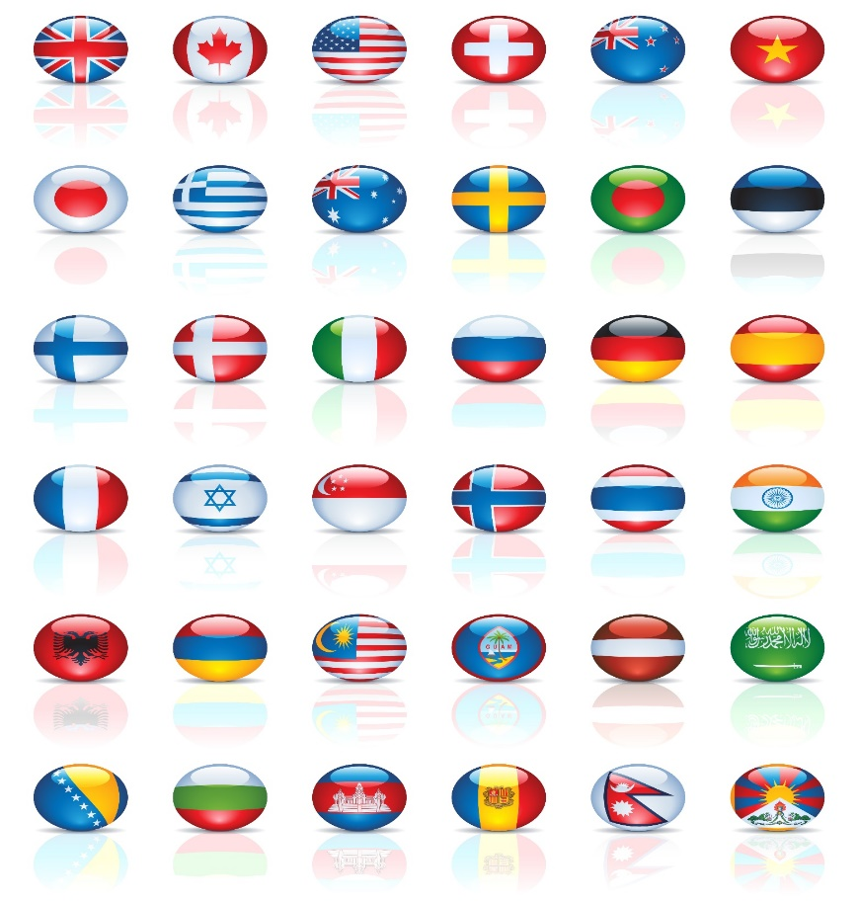
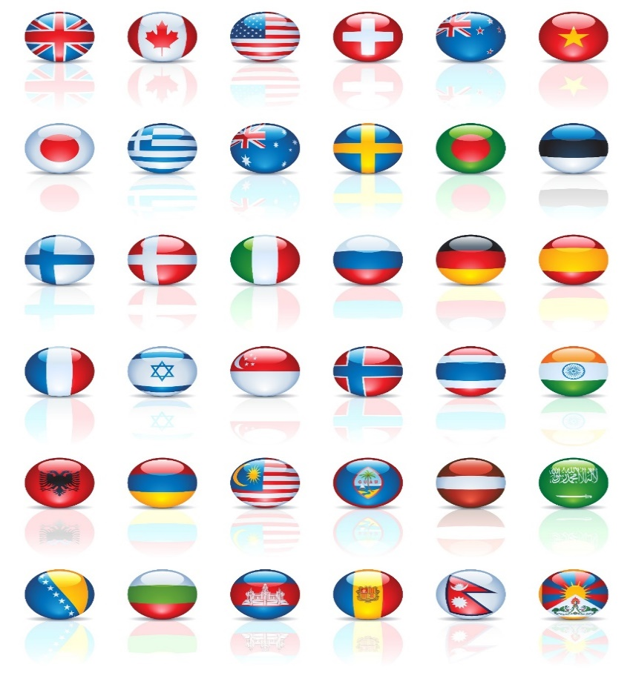

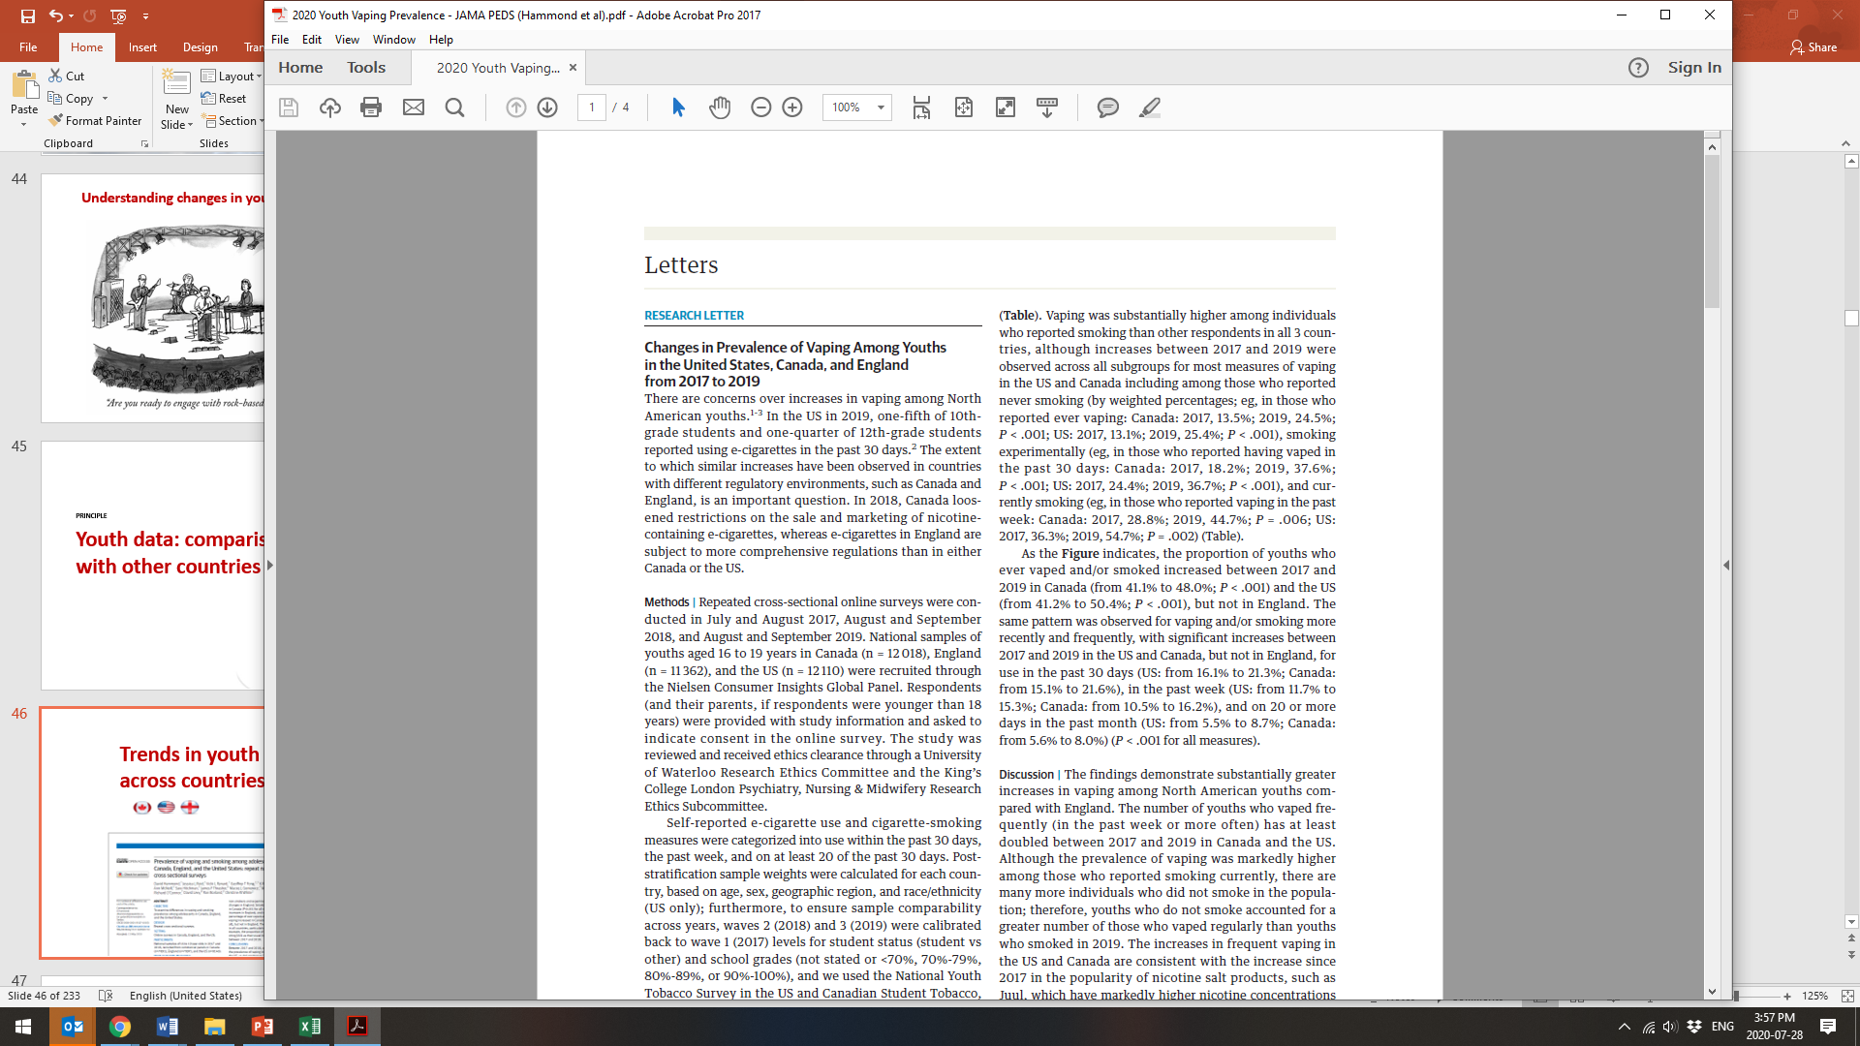

Trends in youth vaping across countries

Slide 4
ITC Youth Surveys
Methods
Repeat cross-sectional surveys
Ages 16 – 19
Nielsen non-probability samples
Weighted data
Age, sex, geographic region, race (US), student status, school grades, smoking status (CA, US)*
Same methods across countries
*WEIGHTED ON SMOKING STATUS IN THE US (NYTS) AND CANADA (CSTADS), AND RACE/ETHNICITY IN US ONLY.
ITC YOUTH TECHNICAL REPORT AVAILABLE AT: HTTP://DAVIDHAMMOND.CA/PROJECTS/E-CIGARETTES/ITC-YOUTH-TOBACCO-ECIG/

Slide 5
ITC YOUTH SURVEY
Analytic sample
N=63,664
2017
2018
2020 FEB
2020 AUG
2019
4,038
4,095
3,995
3,845
4,034
3,874
4,135
3,981
3,493
4,217
5,132
4,275
4,269
4,290
5,991
12,128
11,753
11,609
13,624
14,550

Slide 6
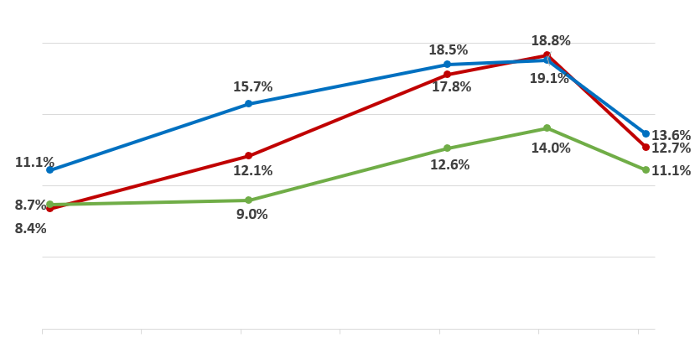
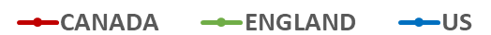
Vaping - Past 30 days
2017-2020 N=63,664
2017 AUG
2018 AUG
2019 AUG
2020 FEB
2020 AUG

Slide 7
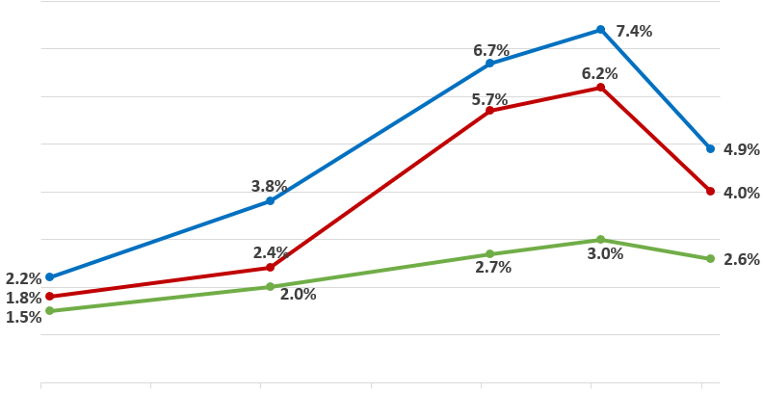
Vaping - 20+ days past month
2017-2020 N=63,664
2017 AUG
2018 AUG
2019 AUG
2020 FEB
2020 AUG

Slide 8
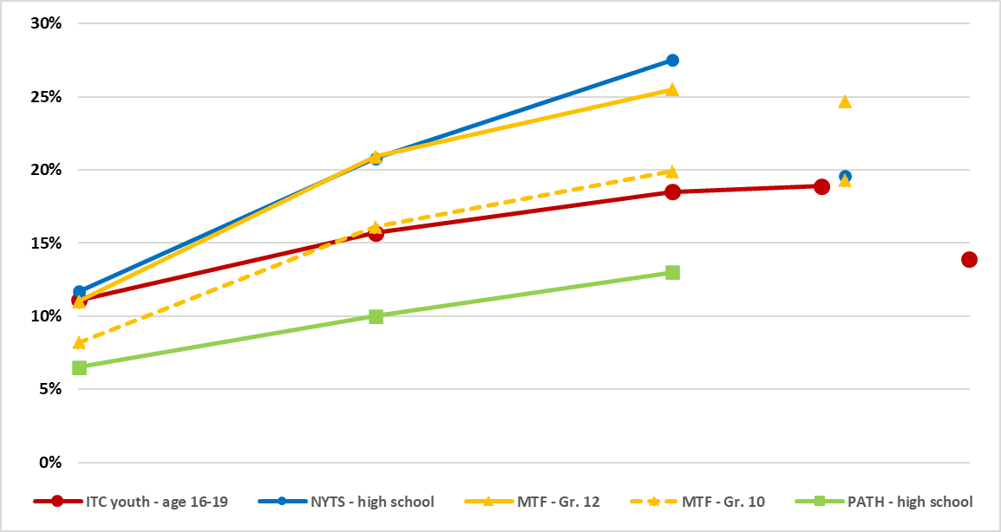
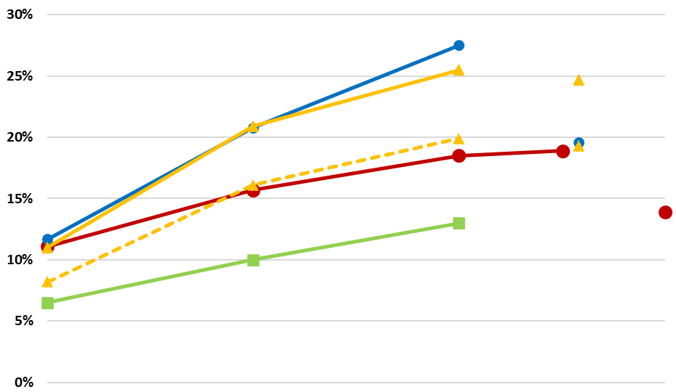
Comparisons across surveys - Past 30-day vaping
2017 AUG
2018 AUG
2019 AUG
2020 FEB
2020 AUG

Slide 9
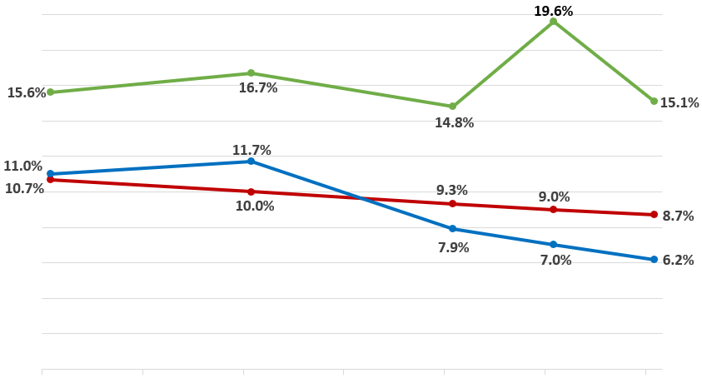
Smoking - Past 30 days
2017-2020 N=63,664
*Adjusted for smoking trend in US & Canada
2017 AUG
2018 AUG
2019 AUG
2020 FEB
2020 AUG

Slide 10


Symptoms of dependence among youth vapers

Slide 11
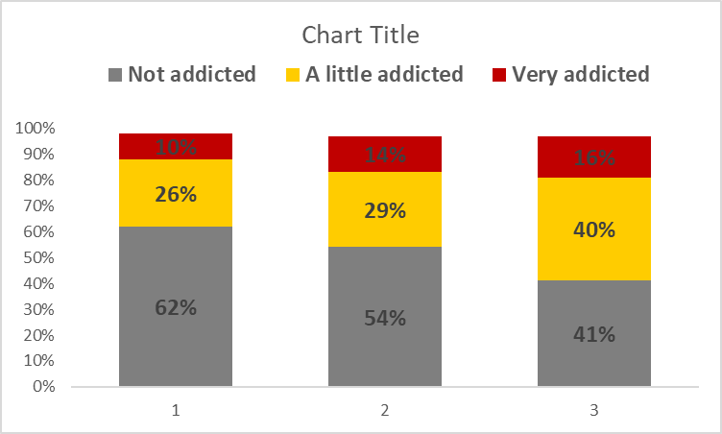
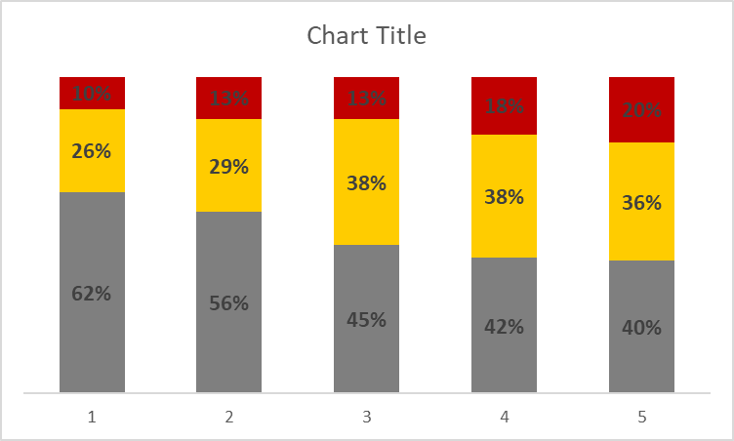
Do you consider yourself addicted to e-cigarettes?
PAST 30-DAY VAPERS – US ONLY
2017 AUG
2018 AUG
2019 AUG
2020 FEB
2020 AUG

Slide 12
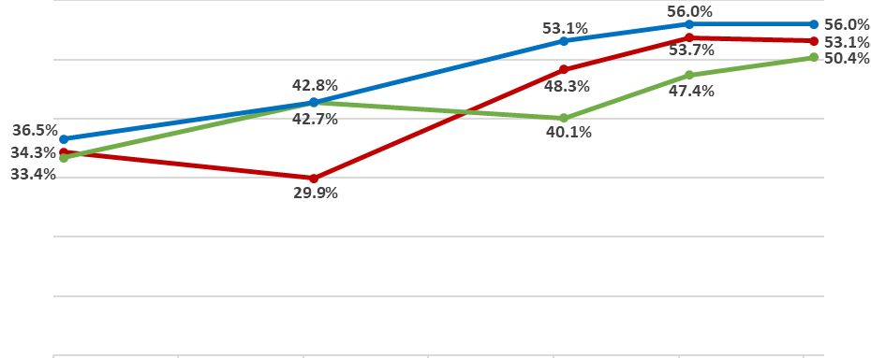
Perceived addiction – ‘A little / Very’
PAST 30-DAY VAPERS
2017 AUG
2018 AUG
2019 AUG
2020 FEB
2020 AUG

Slide 13
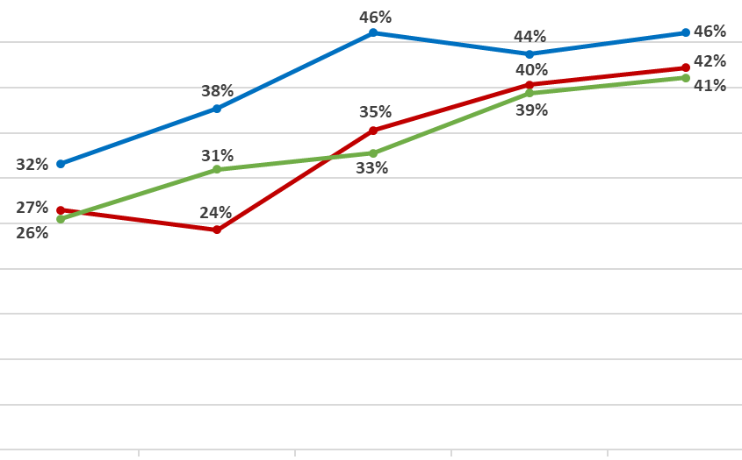
Strong urges to vape at least most days
PAST 30-DAY VAPERS
2017 AUG
2018 AUG
2019 AUG
2020 FEB
2020 AUG

Slide 14
ITC YOUTH SURVEY
Why has youth vaping increased more in North America than England?

Slide 15
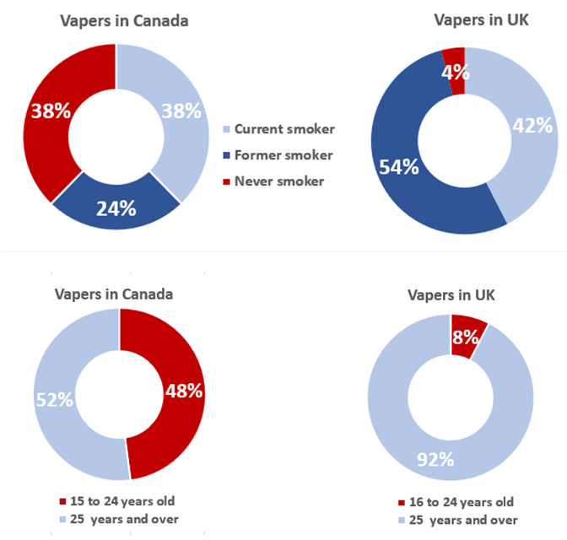
Differences in vaping markets
SOURCES:
CANADA: https://www.canada.ca/en/health-canada/services/canadian-tobacco-nicotine-survey/2019-summary/2019-detailed-tables.html
UK: https://www.ons.gov.uk/peoplepopulationandcommunity/healthandsocialcare/drugusealcoholandsmoking/datasets/ecigaretteuseingreatbritain

Slide 16
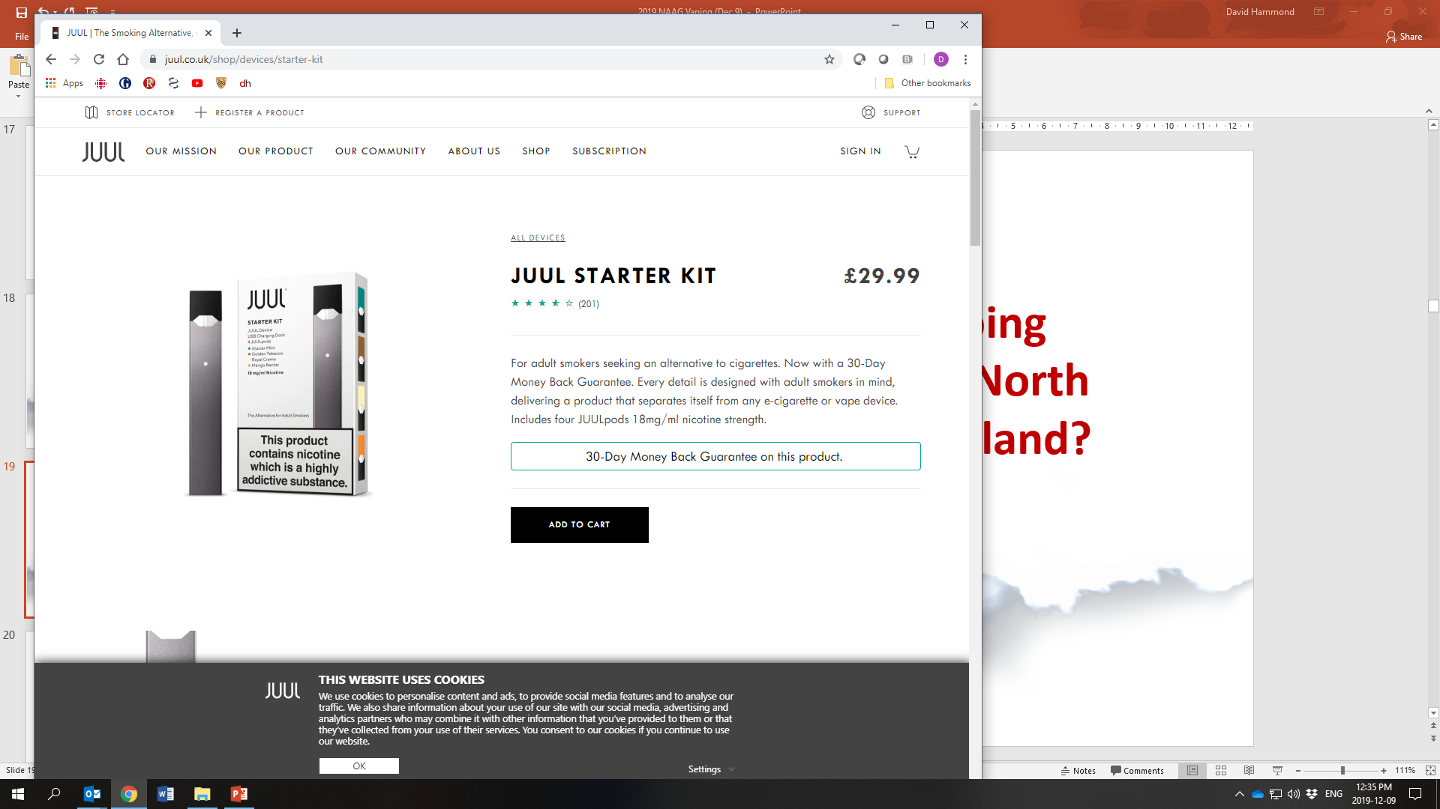
ITC YOUTH SURVEY
Different products.
Soruce: https://www.juul.co.uk/shop/devices/starter-kit

Slide 17
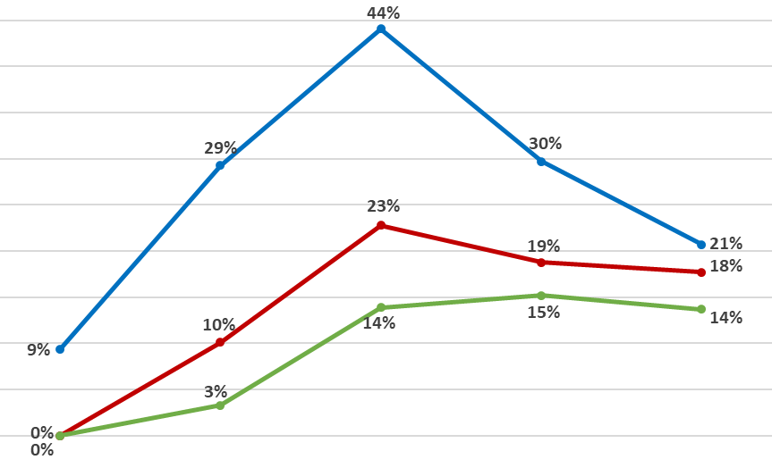
Usual vape brand - JUUL
AMONG PAST 30-DAY VAPERS 2017-2020
2017 AUG
2018 AUG
2019 AUG
2020 FEB
2020 AUG

Slide 18
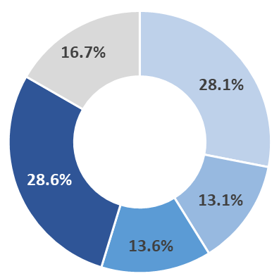
How much nicotine do the e-cigarettes, cartridges, pods, or e-liquids you currently use contain?
PAST 30-DAY VAPERS, US ONLY, 2020 AUG
Don’t know
None
≥5.0%
< 2.0%
2.0 – 4.9%

Slide 19
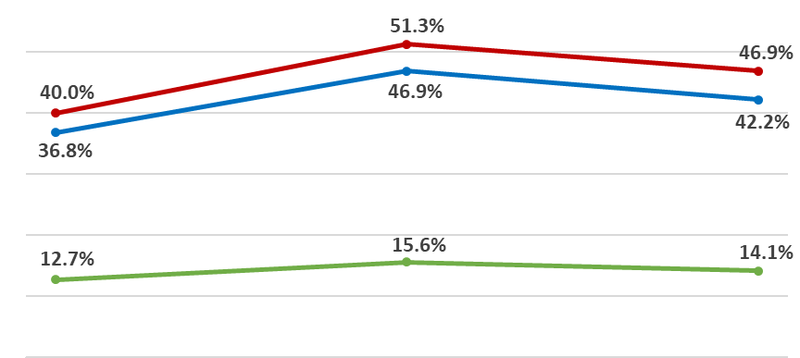
Nicotine concentration - ≥2% / 20mg
SELF-REPORTED, AMONG PAST 30-DAY VAPERS
2019 AUG
2020 FEB
2020 AUG

Slide 20
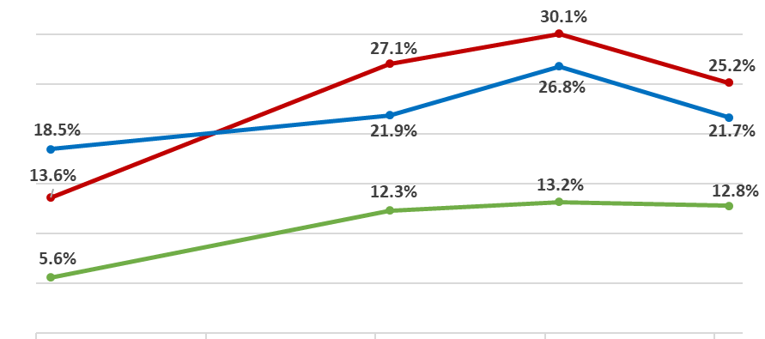
Nicotine Salts – Current use
SELF-REPORTED, AMONG PAST 30-DAY VAPERS
ITC adults
19%
13%
5%
2018 AUG
2019 AUG
2020 FEB
2020 AUG

Slide 21
Product type is associated with dependence indicators.

Slide 22
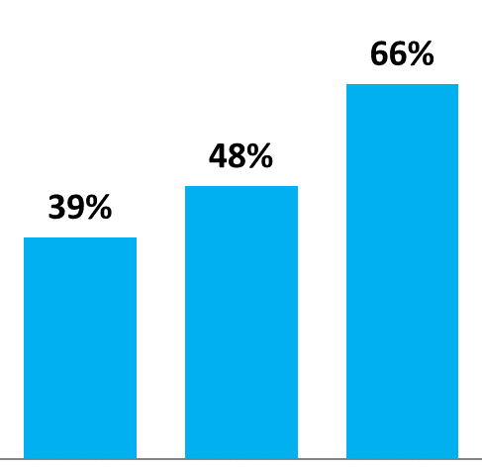
Perceived addiction
‘A LITTLE’ OR ‘VERY ADDICTED’, 2019
AOR=4.6 95%CI=3.6-6.0
AOR=3.2
95%CI=2.4-4.1
No nicotine
/ DK
≥ 2% Nicotine
<2 % Nicotine
ADJUSTED ODDS RATIOS FORM LOGISTIC REGRESSION MODELS ADJUSTED FOR COUNTRY, AGE GROUP, SEX, AND RACE/ETHNICITY.

Slide 23
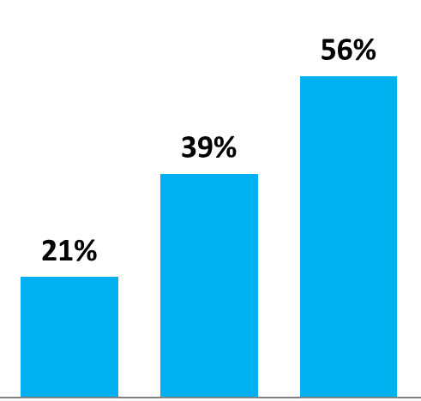
Urges to vape
% WHO HAVE STRONG URGES TO USE ‘SEVERAL TIMES A DAY’ / ‘EVERY DAY OR MOST DAYS’, 2019
AOR=4.9 95%CI=3.7-6.4
AOR=3.6
95%CI=2.7-4.8
No nicotine
/ DK
≥ 2% Nicotine
<2 % Nicotine
ADJUSTED ODDS RATIOS FORM LOGISTIC REGRESSION MODELS ADJUSTED FOR COUNTRY, AGE GROUP, SEX, AND RACE/ETHNICITY.

Slide 24
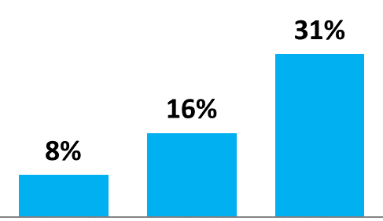
Vape more than 20 times per day
AMONG PAST 30 DAY VAPERS, 2019
No nicotine
/ DK
<2 % Nicotine
≥ 2% Nicotine
ADJUSTED ODDS RATIOS FORM LOGISTIC REGRESSION MODELS ADJUSTED FOR COUNTRY, AGE GROUP, SEX, AND RACE/ETHNICITY.

Slide 25
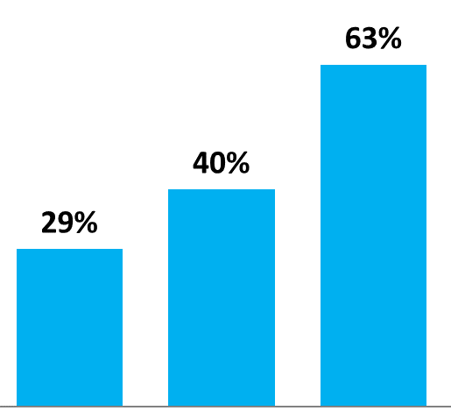
Dependence indicators equally high or higher for non-JUUL nicotine salt products.
Urges to vape
% WHO HAVE STRONG URGES TO USE ‘SEVERAL TIMES A DAY’ / ‘EVERY DAY OR MOST DAYS’
AOR=4.1 95%CI=3.1-5.6
AOR=1.5
95%CI=1.1-1.9
No nicotine
Salts or JUUL
JUUL
Non-JUUL salts brands

Slide 26
Why has youth vaping increased more in North America than England?
Different marketing.

Slide 27
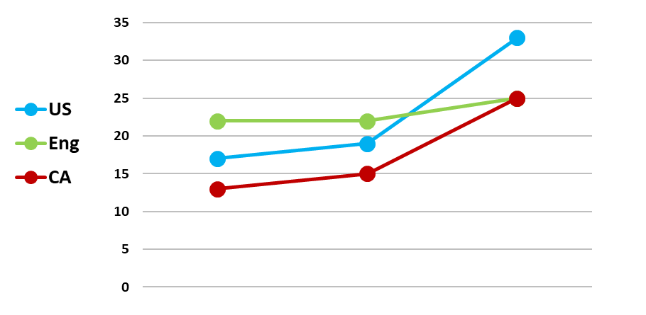
In the last 30 days, how often have you noticed things that promote e-cigarettes?
% OFTEN OR VERY OFTEN
2017
2018
2019

Slide 28

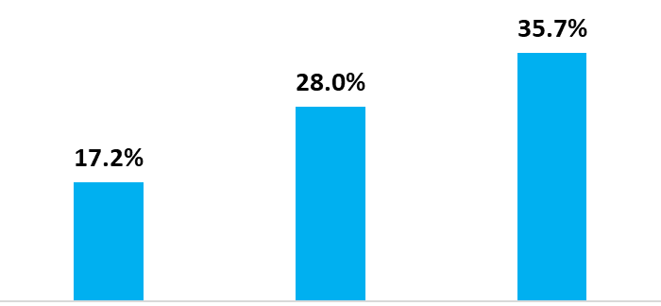
In the last 30 days, how often have you noticed things that promote e-cigarettes/vaping?
% OFTEN OR VERY OFTEN 2019 N=4,135
High restrictions
Moderate restrictions
Low restrictions
QC, MB, NS, PEI
BC, NF, NB, ON
SK, AB

Slide 29
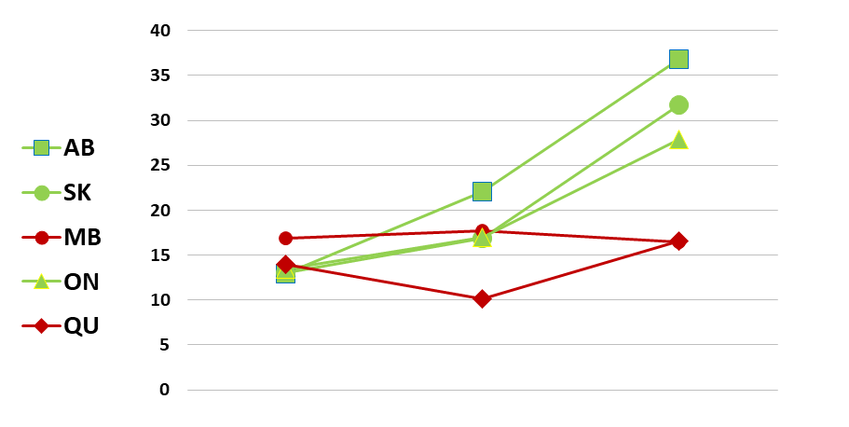
In the last 30 days, how often have you noticed things that promote e-cigarettes/vaping?
% OFTEN OR VERY OFTEN
2017
2018
2019

Slide 30
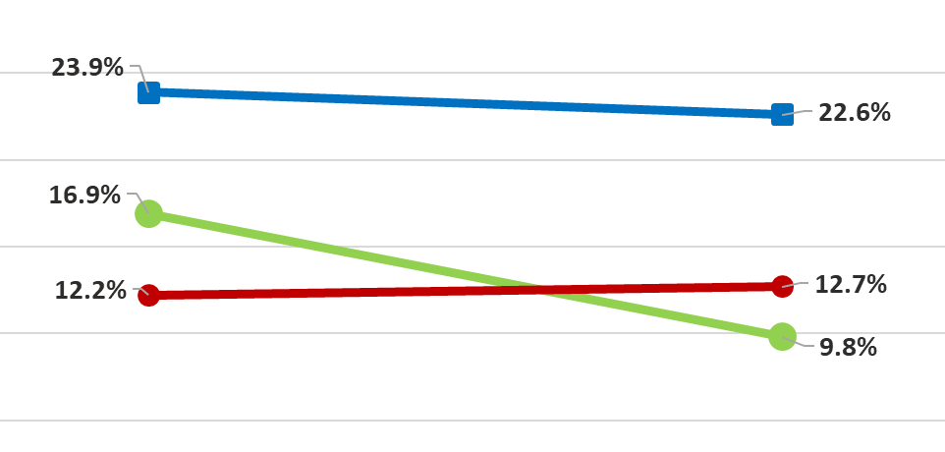
Noticing e-cigarette marketing
Adults smokers and former smokers
ITC ADULT SURVEY - NOTICING E-CIGARETTE MARKETING ON TELEVISION, RADIO, POSTERS, BILLBOARDS, NEWSPAPERS OR MAGAZINES
2016
2018

Slide 31
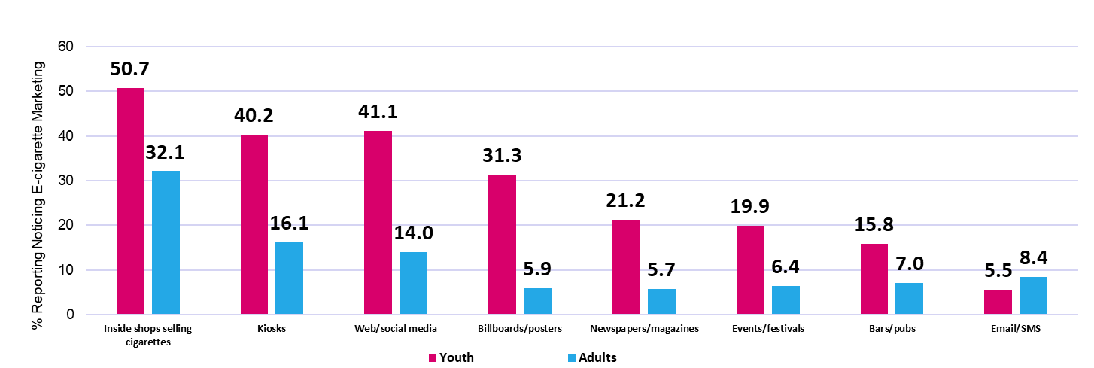
Noticing e-cigarette marketing
Adults vs. youth
2018 ITC ADULT SURVEY VS. 2018 ITC YOUTH TOBACCO AND VAPING SURVEY

Slide 32
Noticing e-cigarette marketing
Adults smokers vs. youth ‘never smokers’
2018 ITC ADULT SURVEY VS. 2018 ITC YOUTH TOBACCO AND VAPING SURVEY

Slide 33

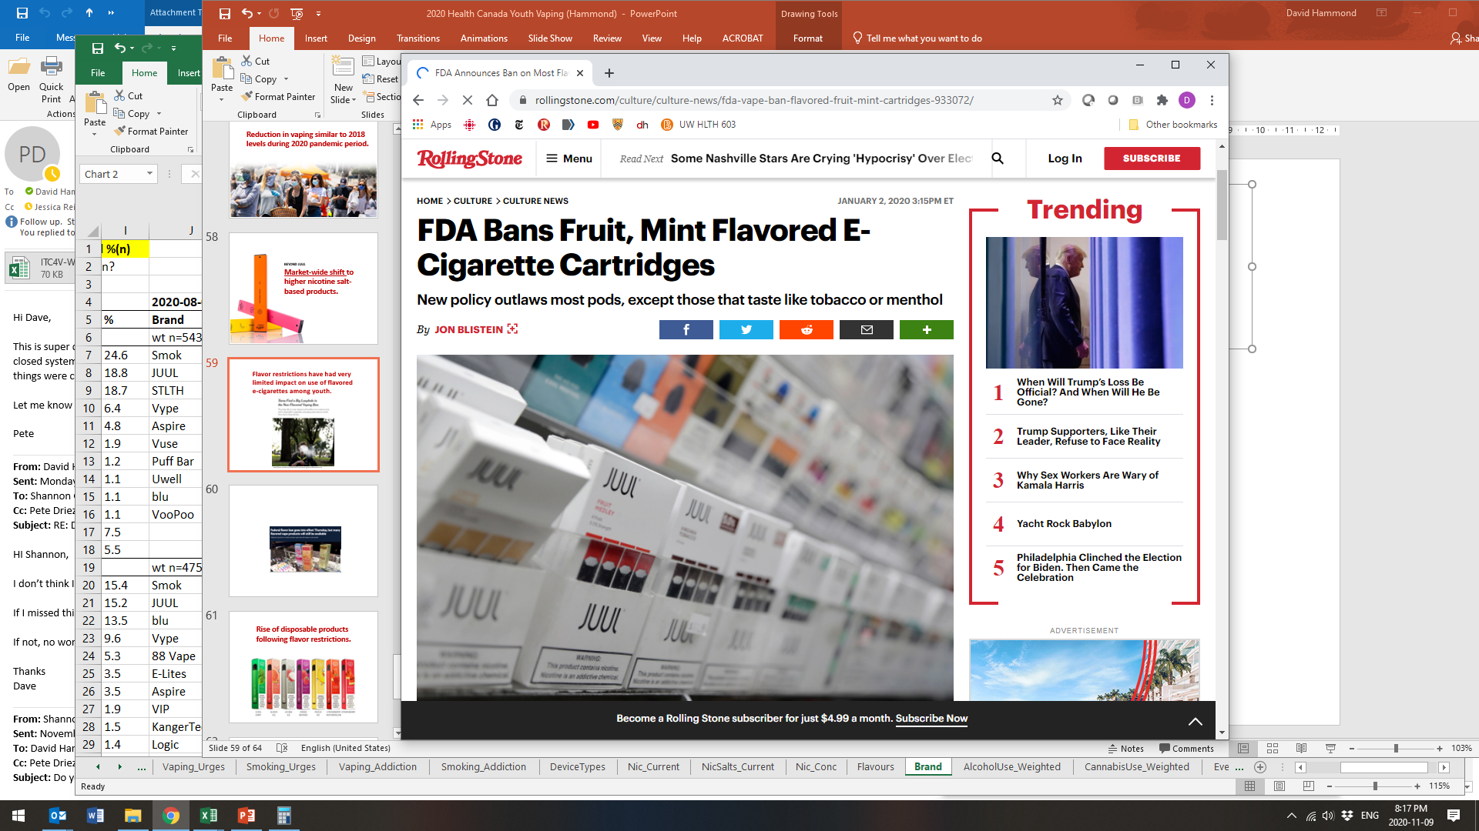
Impact of US flavor restrictions?
HTTPS://WWW.ROLLINGSTONE.COM/CULTURE/CULTURE-NEWS/FDA-VAPE-BAN-FLAVORED-FRUIT-MINT-CARTRIDGES-933072/

Slide 34
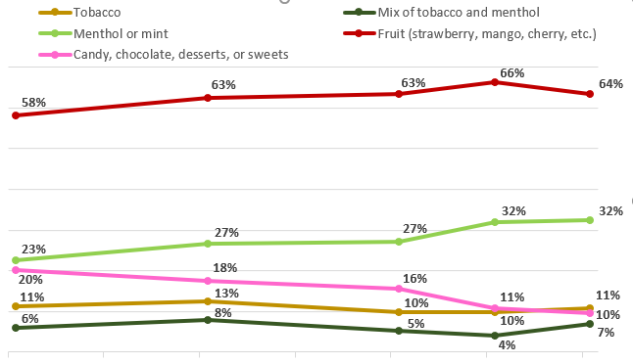
‘Usual’ e-cigarette flavors
TOP 5 FLAVORS US ONLY - PAST 30-DAY VAPERS , AGE 16 -19
2017 AUG
2018 AUG
2019 AUG
2020 FEB
2020 AUG

Slide 35
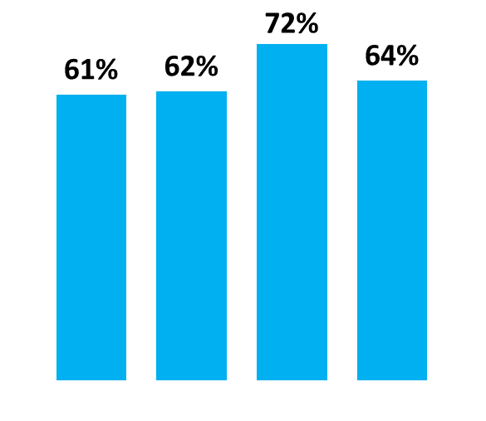
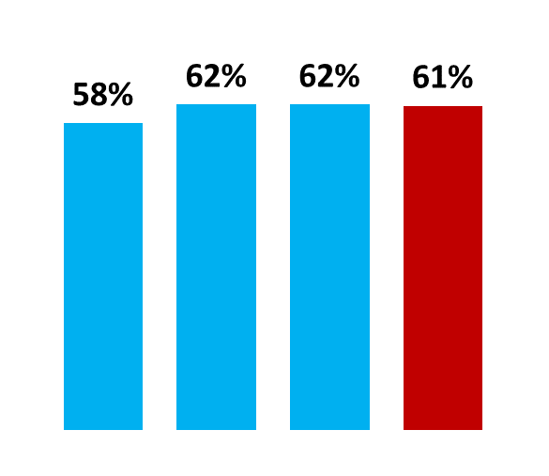
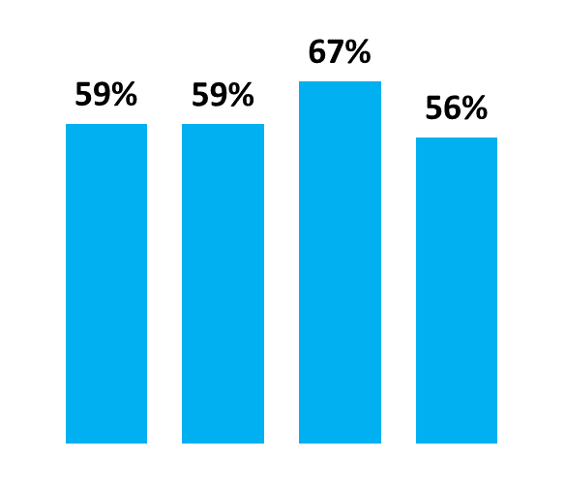
Which country banned fruit flavor in cartridges in 2020?
Fruit flavored e-cigarettes
‘USUAL’ E-CIGARETTRE FLAVOR - PAST 30-DAY VAPERS, AGE 16 -19
2017
2018
2019
2020*
2017
2018
2019
2020*
2017
2018
2019
2020*
HAMMOND D, ET AL. E-CIGARETTE FLAVOURS AND DEVICE TYPES: THE IMPACT OF FLAVOUR RESTRICTIONS IN THE US. OCTOBER, 2020.

Slide 36
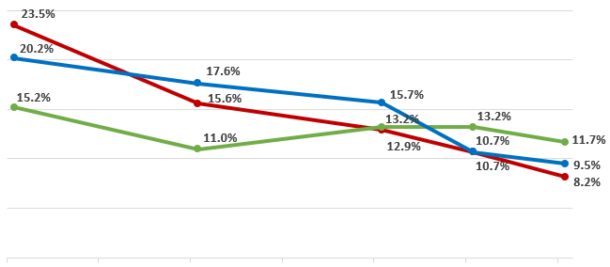
Usual e-cigarette flavor - Candy or dessert
AMONG PAST 30-DAY VAPERS , AGE 16 -19
2017 AUG
2018 AUG
2019 AUG
2020 FEB
2020 AUG

Slide 37
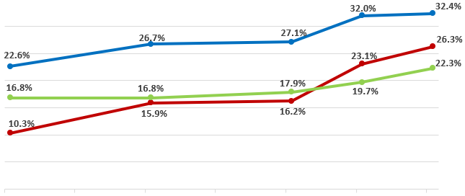
Usual e-cigarette flavor - Menthol or mint
AMONG PAST 30-DAY VAPERS , AGE 16 -19
2017 AUG
2018 AUG
2019 AUG
2020 FEB
2020 AUG

Slide 38
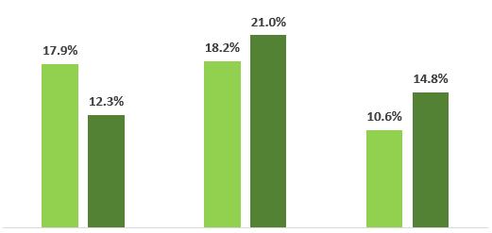
Mint vs. menthol flavored e-cigarettes
AUG 2020 ‘USUAL’ E-CIGARETTRE FLAVOR AMONG PAST 30-DAY VAPERS, AGE 16 -19
MINT
MENTHOL
MINT
MENTHOL
MINT
MENTHOL

Slide 39
What types of products are youth using?

Slide 40
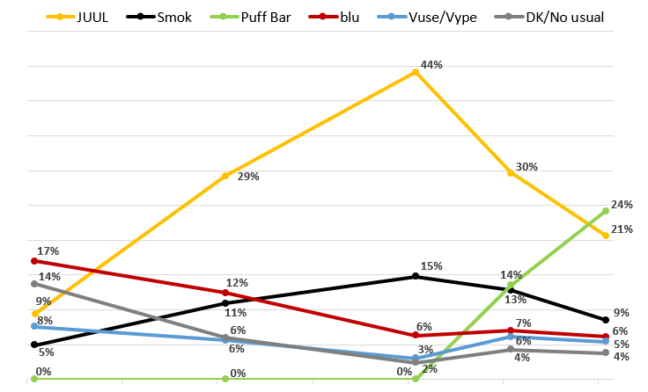
Usual vape brand - US
TOP 5 BRANDS AMONG PAST 30-DAY VAPERS, 2017-2020
2017 AUG
2018 AUG
2019 AUG
2020 FEB
2020 AUG

Slide 41
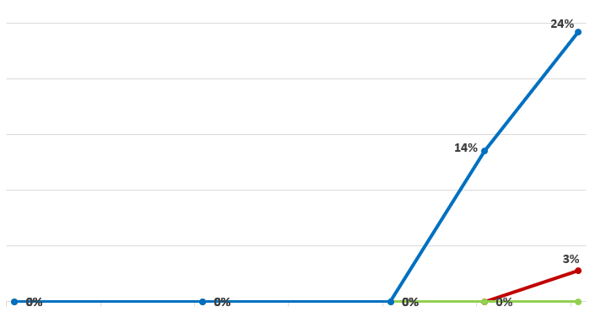
Usual vape brand – Puff Bar
AMONG PAST 30-DAY VAPERS 2017-2020
2017 AUG
2018 AUG
2019 AUG
2020 FEB
2020 AUG

Slide 42
Usual vape brand - JUUL
AMONG PAST 30-DAY VAPERS 2017-2020
2017 AUG
2018 AUG
2019 AUG
2020 FEB
2020 AUG

Slide 43
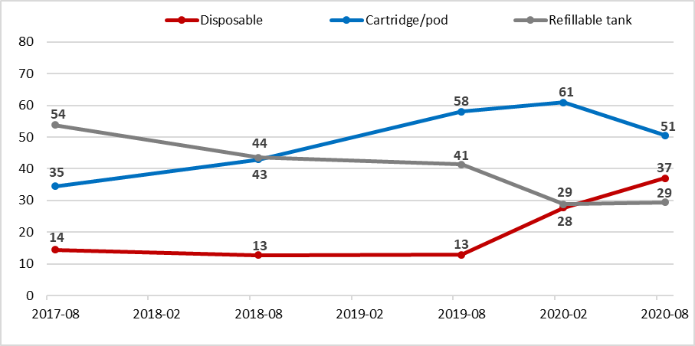
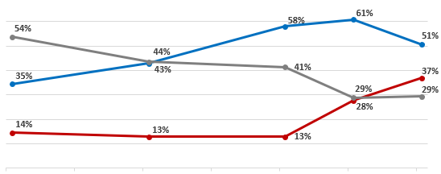
Type of e-cigarette device used ‘most often’
PAST 30-DAY VAPERS – US, AGE 16 -19
2017 AUG
2018 AUG
2019 AUG
2020 FEB
2020 AUG

Slide 44
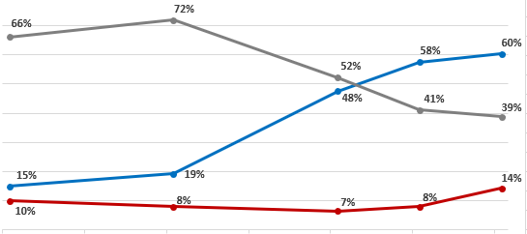
Type of e-cigarette device used ‘most often’
PAST 30-DAY VAPERS – CANADA, AGE 16 -19
2017 AUG
2018 AUG
2019 AUG
2020 FEB
2020 AUG

Slide 45
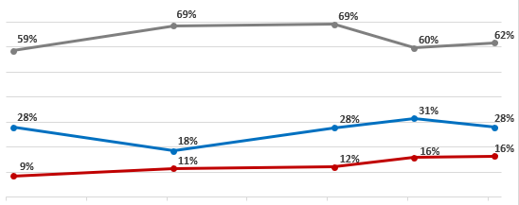
Type of e-cigarette device used ‘most often’
PAST 30-DAY VAPERS – ENGLAND, AGE 16 -19
2017 AUG
2018 AUG
2019 AUG
2020 FEB
2020 AUG

Slide 46
Menthol cigarette ban

Slide 47

Menthol ban in cigarettes
Canada 2017
England 2020 (March)

Slide 48
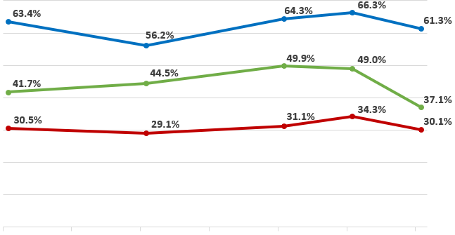
Use of flavoured menthol or mint cigarettes in past 30 days
AMONG PAST 30-DAY SMOKERS
2017 AUG
2018 AUG
2019 AUG
2020 FEB
2020 AUG

Slide 49
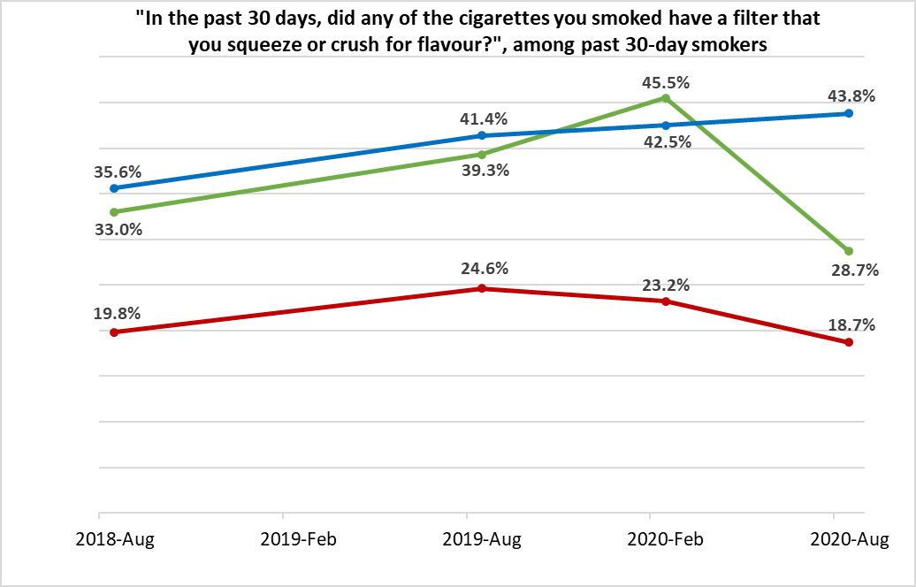
Use of cigarettes with ‘squeeze or crush’ flavour capsules – Past 30 days
AMONG PAST 30-DAY SMOKERS
2018 AUG
2019 AUG
2020 FEB
2020 AUG

Slide 50
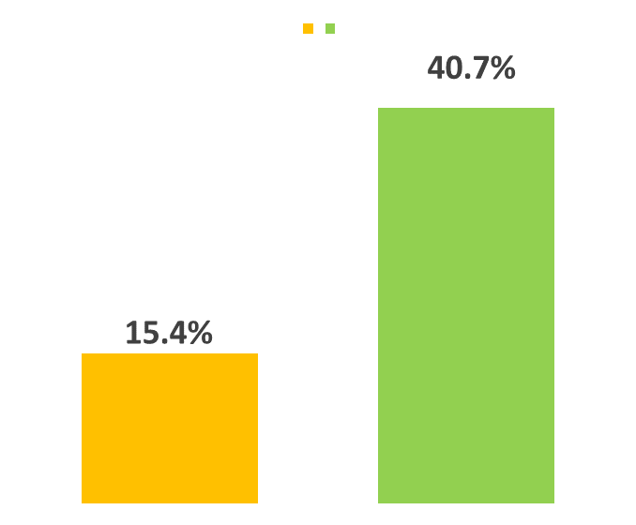
Use of ‘unregulated’ cigarettes Past 30 Days
AMONG PAST 30-DAY SMOKERS – CANADA ONLY AUG 2020, N=320
NO MENTHOL
PAST 30 DAYS
MENTHOL
PAST 30 DAYS
*“IN THE PAST 30 DAYS, WERE ANY OF THE CIGARETTES YOU SMOKED FROM A FIRST NATIONS RESERVE, OR CIGARETTES THAT YOU BELIEVE MAY HAVE BEEN SMUGGLED OR FAKE?”, AMONG PAST 30-DAY SMOKERS”

Slide 51
Summary

Slide 52
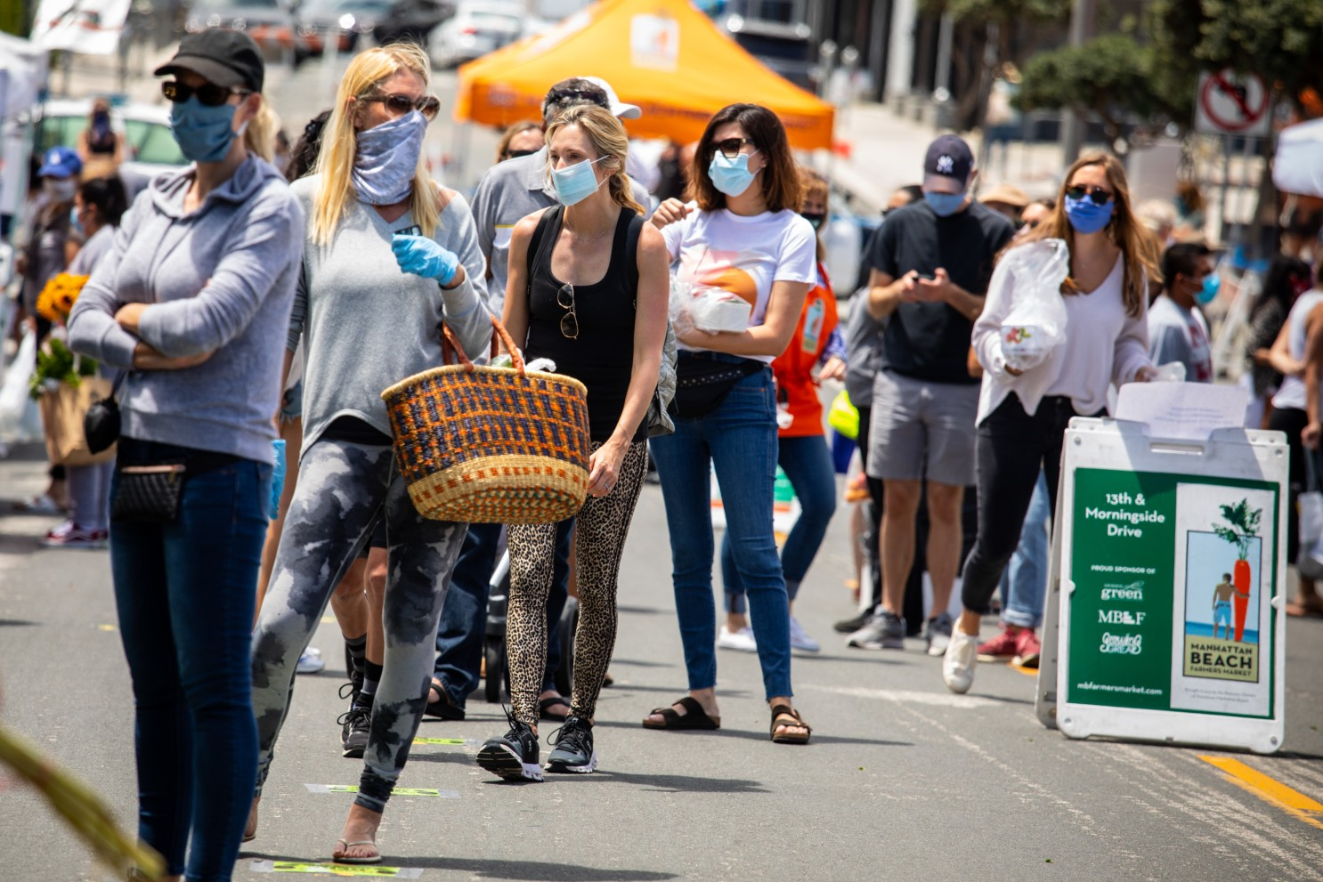
Reduction in vaping to 2018 levels during 2020 pandemic period.

Slide 53
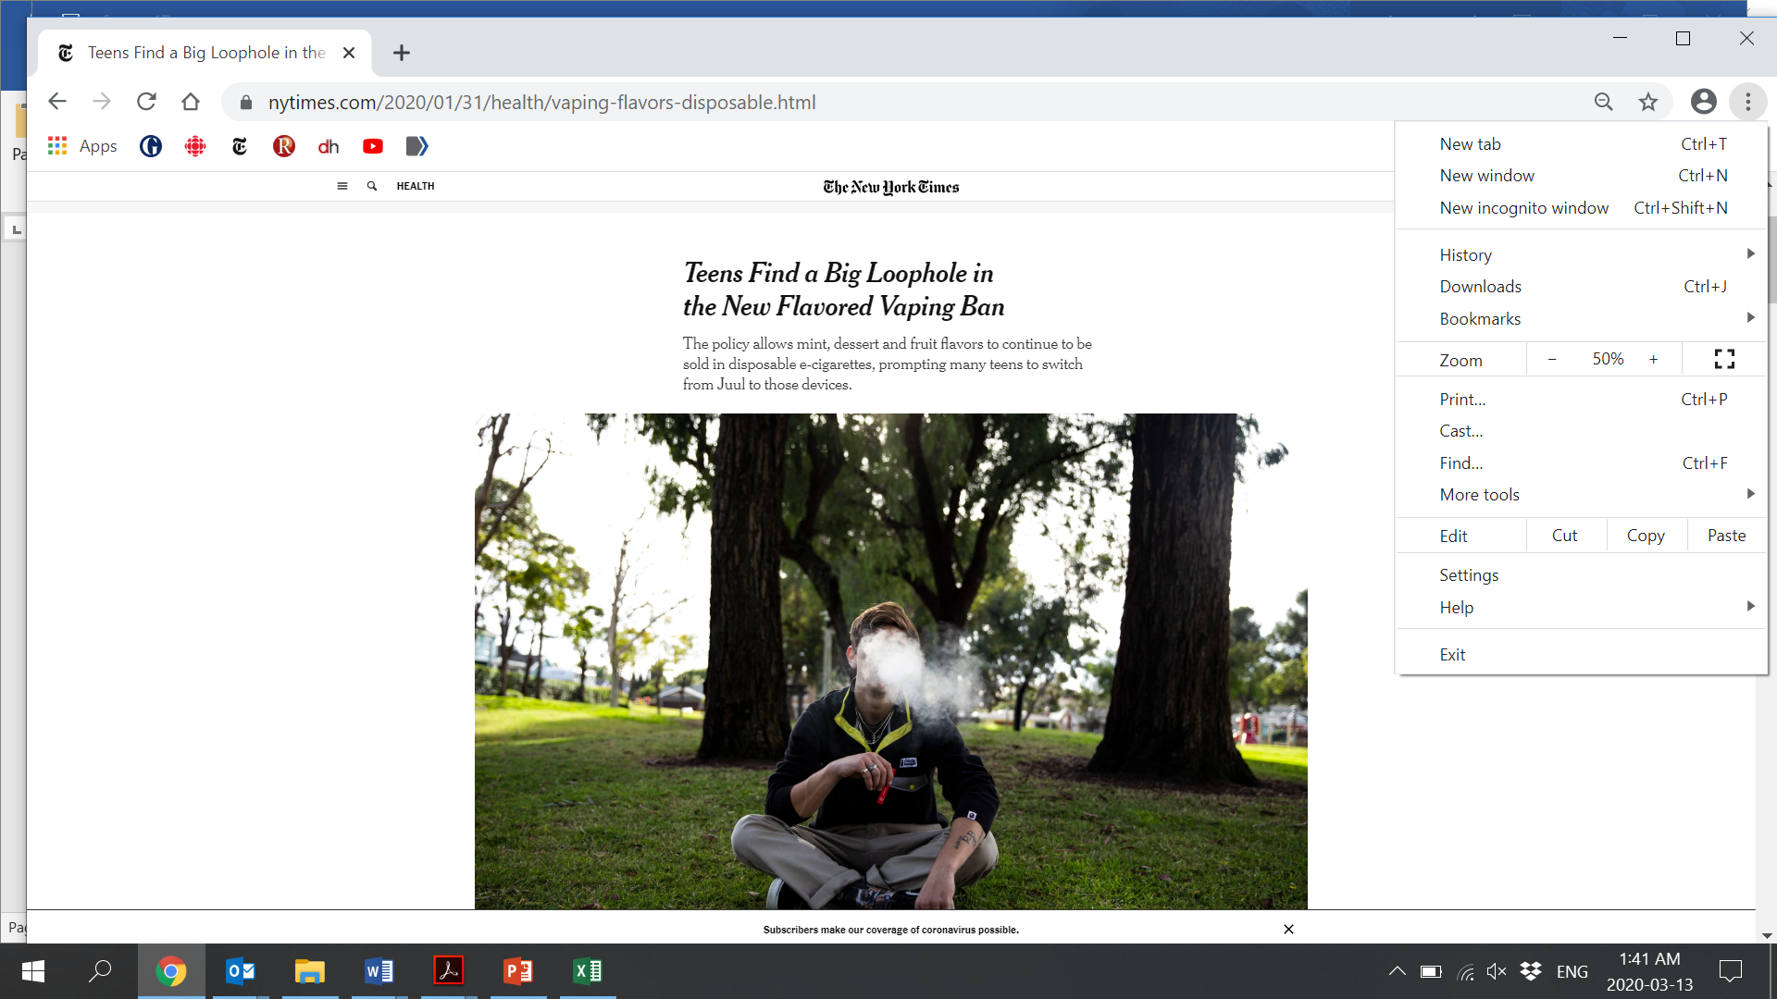
Flavor restrictions have had limited if any impact on use of flavored e-cigarettes among youth.
https://www.nytimes.com/2020/01/31/health/vaping-flavors-disposable.html

Slide 54
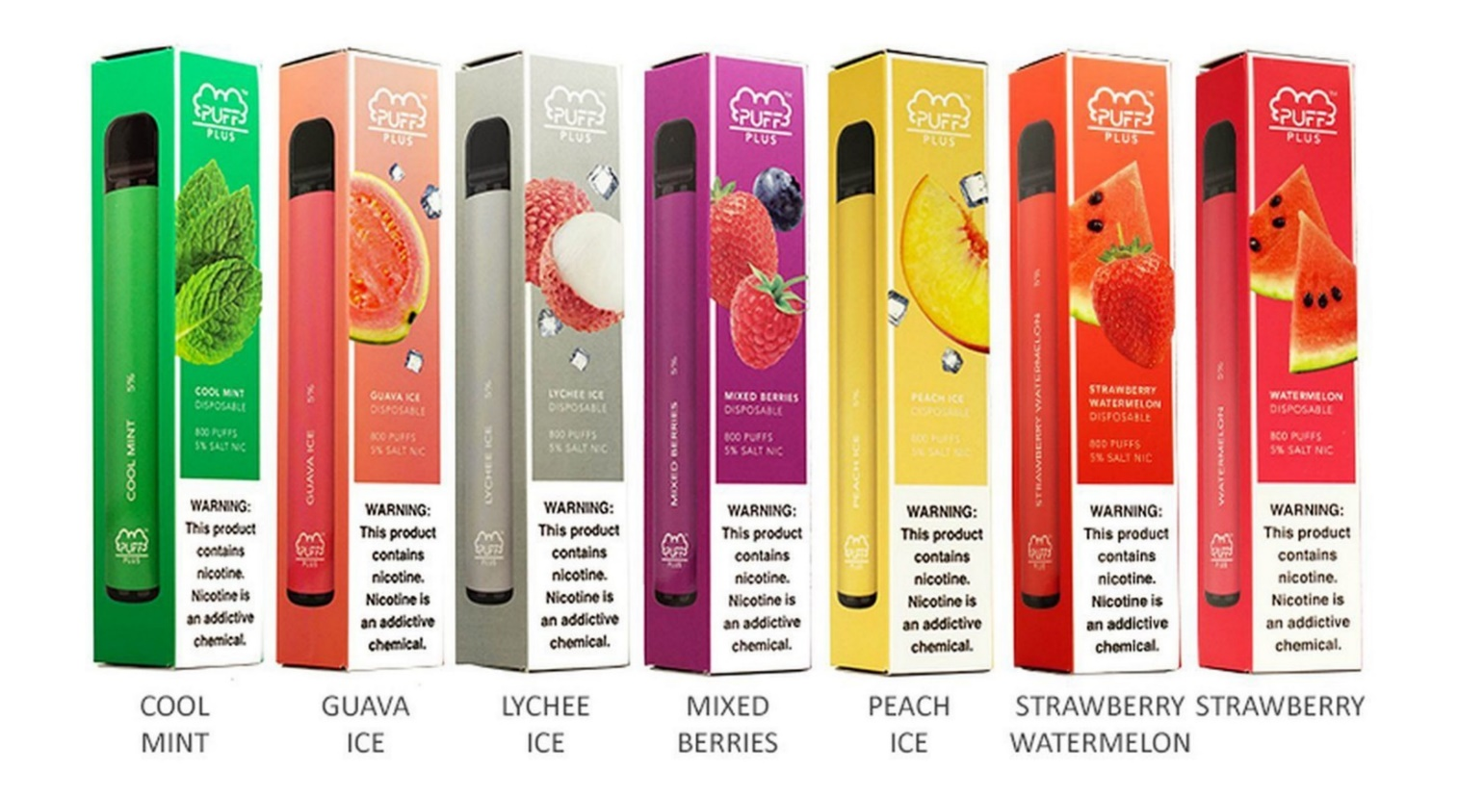
Rise of disposable products following flavor restrictions.
Notes:
2020 NYTS: Among high school current e-cigarette users, the most commonly used device type was prefilled pods or cartridges (48.5%; 1.45 million), followed by disposables (26.5%; 790,000), and tanks (14.8%; 440,000). Among middle school current e-cigarette users, the most commonly used device type was prefilled pods or cartridges (41.3%; 220,000), followed by tanks (21.5%; 110,000), and disposables (15.2%; 80,000)
CDC RETAIL SALES ANALYSIS: https://www.cdc.gov/mmwr/volumes/69/wr/mm6937e2.htm

Slide 55
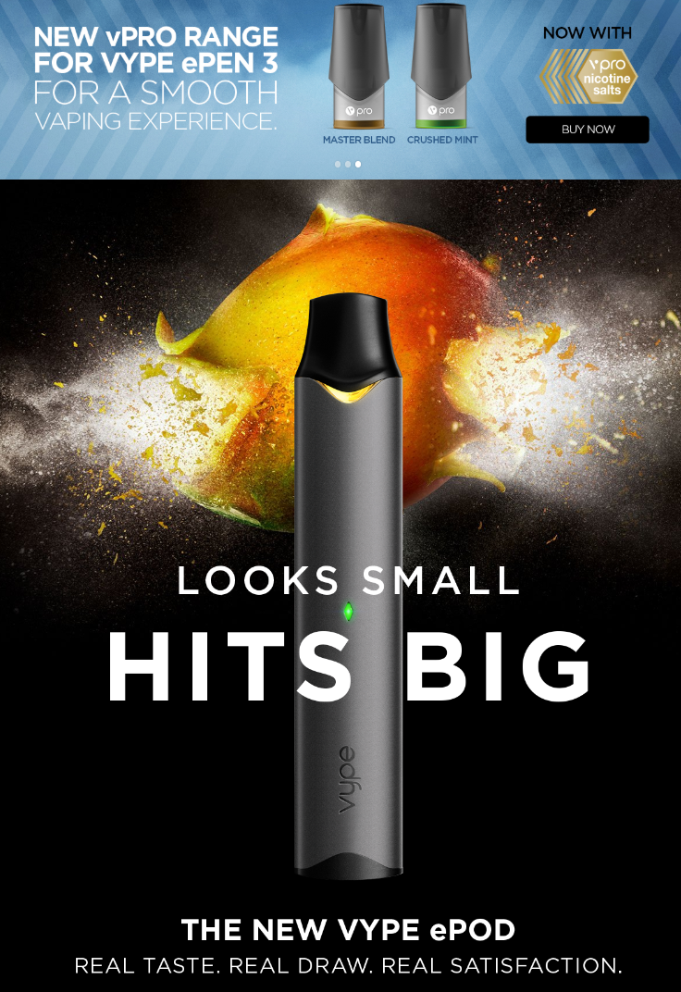
PRIORITIES
Market-wide shift to higher nicotine salt-base products, which are associated with greater dependence symptoms.
HTTPS://GOVYPE.CA/

Slide 56
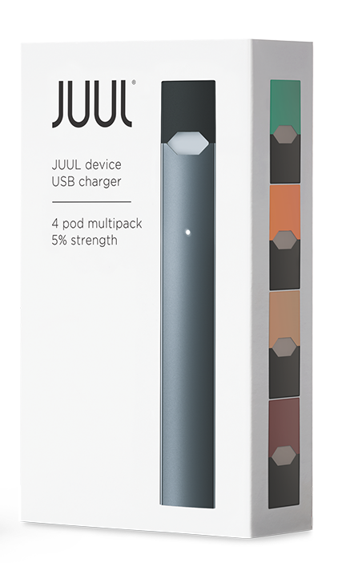
BAD NEWS
Vapes can deliver nicotine like cigarettes.
https://www.juul.ca/shop/devices/starter-kit

Slide 57
GOOD NEWS
Vapes can deliver nicotine like cigarettes.
https://www.juul.ca/shop/devices/starter-kit

Slide 58

Marketing has had greater impact on youth vaping compared to adult vaping.

Slide 59

Decreased vaping among U.S. adults 30 years and older.
SOURCE: NHIS Data 2014-2019. Bandi et al . Am J Prev Med 2020;000(000):1−8

Slide 60
Largest increases among never-smoking young adults.
SOURCE: NHIS Data 2014-2019. Bandi et al . Am J Prev Med 2020;000(000):1−8

Slide 61
Largest increases among never-smoking young adults.
Only 25% of young adults vape for the purpose of quitting smoking, cutting back, or staying quit.
DAI H, LEVENTHAL AM. PREVALENCE OF NVP USE AMONG ADULTS IN THE UNITED STATES, 2014-2018. J AM MED ASSOC. 322 (18):1824-1827.
SOURCE: NHIS Data 2014-2019. Bandi et al . Am J Prev Med 2020;000(000):1−8

Slide 62

Opportunities to reduce youth vaping, without discouraging switching among adult smokers?

Slide 63

REGULATIONS
Limits on nicotine content?

Slide 64
International policy innovation
New vaping policies in Canada
Comprehensive marketing restrictions
Nicotine limits
Flavour restrictions
Minimum legal age & retail access
Plain packaging
Health warnings
Price/taxation

Slide 65

Proportionality

Slide 66
Increase restrictions on most harmful products.

Slide 67


Funding
P01 CA200512
Wave 3.5 of this study was funded by a contribution from Health Canada’s Substance Use and Addictions Program. The views expressed herein do not necessarily represent the views of Health Canada.
Applied Public Health Chair

Slide 68


Thank you.
David Hammond PhD
SCHOOL OF PUBLIC HEALTH & HEALTH SYSTEMS
UNIVERSITY OF WATERLOO
WEB DHAMMOND@UWATERLOO.CA
EMAIL WWW.DAVIDHAMMOND.CA
TWITTER @DAVIDHAMMONDPHD

